Slide 1





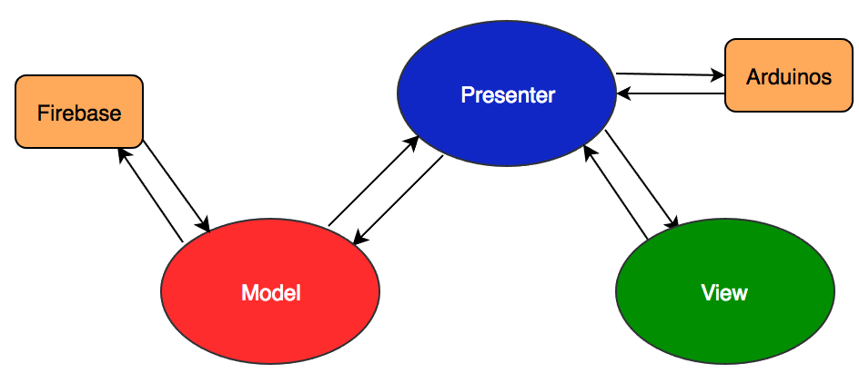

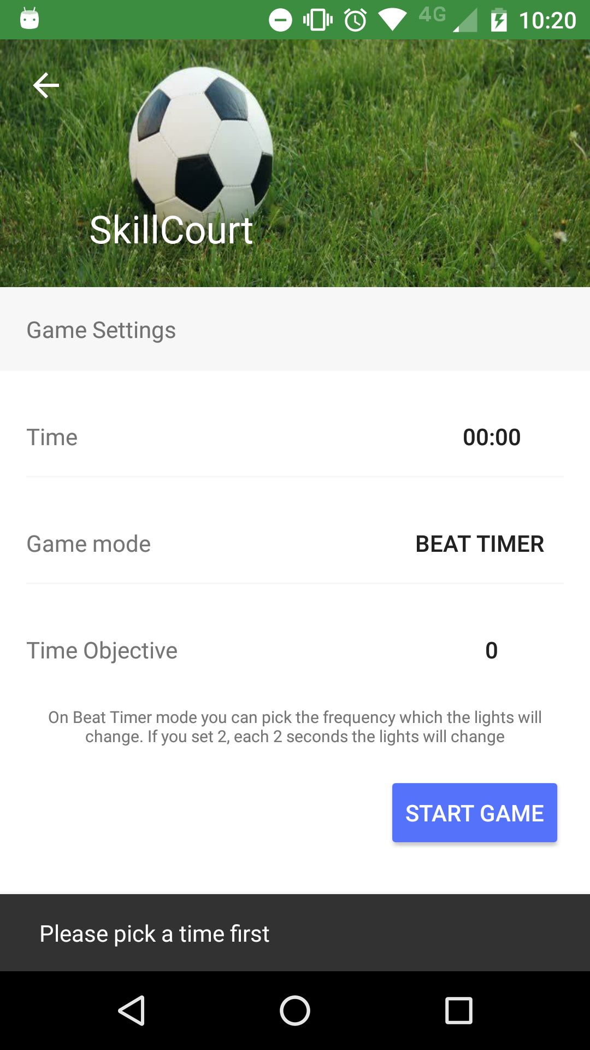
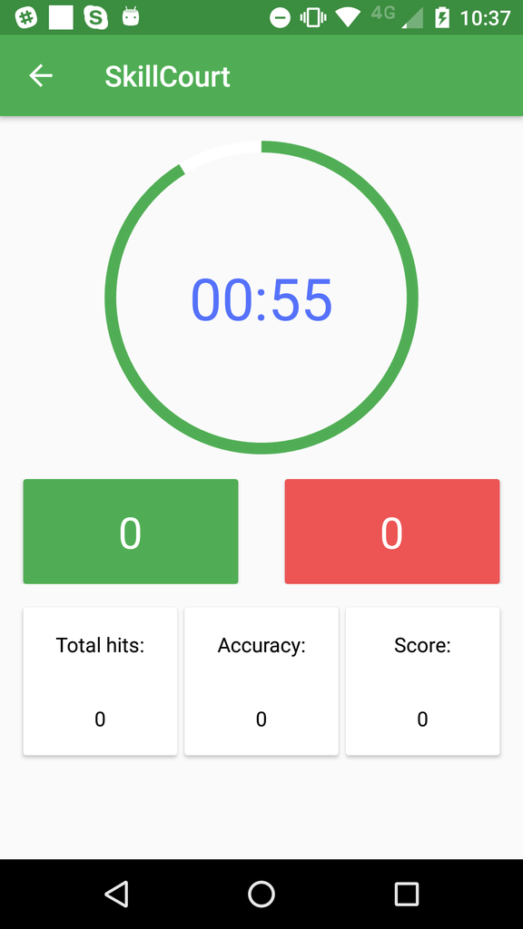

[[1,1],2,[1,1]]
School of Computing & Information Sciences
Advanced Software Engineering, 2016, Fall
Skill Court 6.0
Student: Pedro Carrillo, Florida International University
Product Owner: Gudmundur Orn Traustason, SkillCourt
Instructor: Masoud Sadjadi, Florida International University
Mentor: Mohsen Taheri, Florida International University
Problem
Current System
Requirements
As a user want to:
Know how I am improving as a Soccer player
Have fun and stay engaged while practicing/playing
Get feedback while I’m performing
Get statistics about my performance
Sve my statistics to compare with myself and friends
Create fun passing drills
I did not know I could:
Kick at illuminated targets and get live feedback to my phone
Create passing drills and loop it for x minutes
Play a random sequence to improve my anticipation
Create sequences to save and share with my friends
Get information from playing with graphs and statistics
Status:
You can play two game modes using the android application and communicating with the arduinos
My Core Contributions:
WiFi connection to arduinos
Arduino code
Navigation of the application
Custom steps library
Timer for the game
Detection for losing connection
Game modes implementation
Create game, Game and Dashboard UI
Login and Register with Firebase
Saving data in Firebase
Provided Functionality to users:
Login and Sign up
Create a new game
Start new game
Connect to arduinos using WiFi
Implement Beat timer game mode
Implement Hit pads game mode
Show Main dashboard
Maintain user session
System Design
Object Design
Implementation
SkillCourt is an android application that connects to Firebase to handle the users and also to store the data. It connects through WiFi with the arduinos that are on the same WiFi network.
SkillCourt follows an MVP architecture for the game. This allows us to separate our business logic from our views.
Android Application
Arduino Pads
Firebase
Verification
Screenshots
Summary
Sunny Day - Test case
Name: Create game only when you have connection to arduinos
Purpose: Ensure that you can play a game without any problems
Precondition:
User must be logged in and no arduinos running
Input: User tries to start a new game
Expected Result:
User sees a screen that is attempting to connect to arduinos. It should show a pop up message with “No connection possible”
Actual Result: The user receives a pop up message that there is no connection available.
SkillCourt is a system that will help people from amateur to professional level to improve their cognitive systems. It’s a tool that will keep growing to offer more functionalities. SkillCourt will change how to train soccer and will help to improve a lot of people.
Rainy Day - Test case
Name: Losing internet connection after playing a game
Purpose: You lose information of your next game
Precondition:
User must loses internet connection after he finishes a game
Expected Result:
Despite user press save game, you should lose the game info because of no internet
Actual Result: The game data is saved until the next time you have internet when it’s uploaded to firebase.
Acknowledgement
The material presented in this poster is based upon the work supported by Pedro Carrillo. I am thankful to the help that I received from my group members: April Perry, Rolando Ramos and Jofran Peña
Notes:
1

